Slide 1
Azure - Day 1 Epam DevOps School
Azure Onboarding
Manage Azure resources
Azure Resource Manager
Deploy and manage virtual machines (VMs)
CONFIDENTIAL | © 2020 EPAM Systems, Inc.

Slide 2
AZ-103T00A Module 01: Azure Administration

Slide 3
Module Overview
Azure Portal and Cloud Shell
Azure PowerShell and CLI
Resource Manager
ARM Templates
Notes:
Module overview – this module does not have a lab. Students should try the demonstrations, as needed, to ensure they can use the portal, cloud shell, PowerShell, CLI, and templates.

Slide 4
Lesson 01: Azure Portal and Cloud Shell

Slide 5
Azure Portal and Cloud Shell Overview
Azure Portal
Azure Mobile App
Demonstration – Azure Portal
Azure Cloud Shell
Demonstration – Cloud Shell
Notes:
Lesson overview

Slide 6
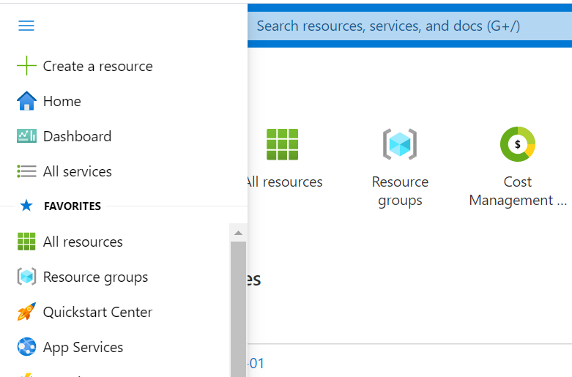
Azure Portal
Search resources, services, and docs
Manage resources
Create customized dashboards and favorites
Access the Cloud Shell
Receive notifications

Slide 7
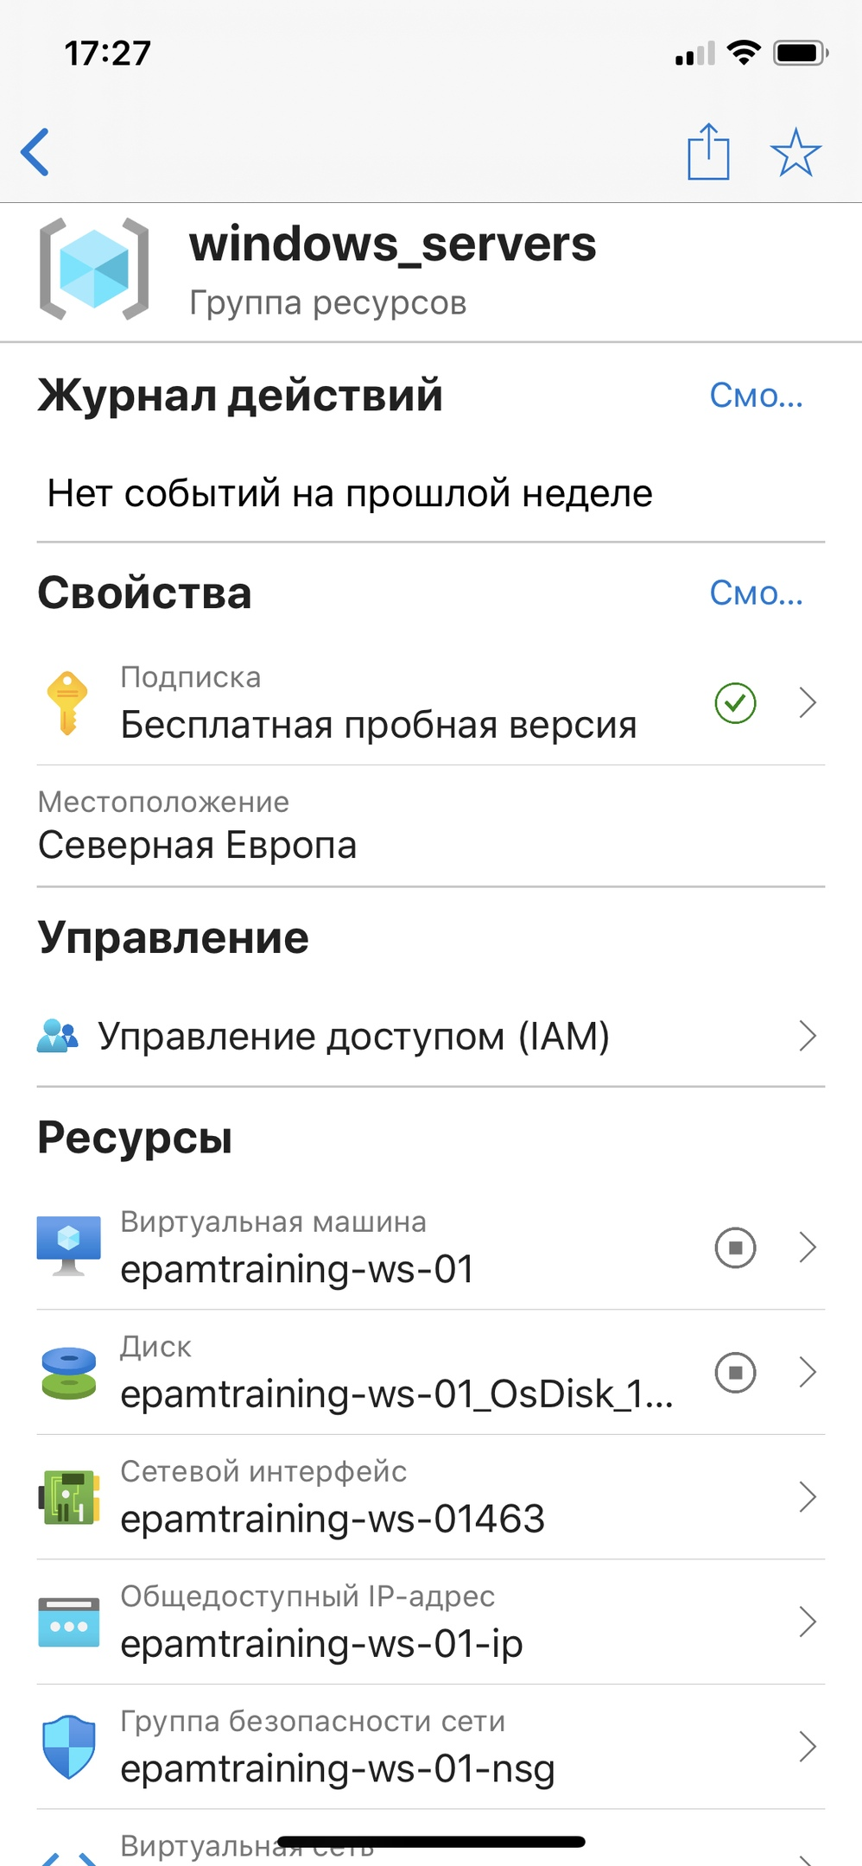
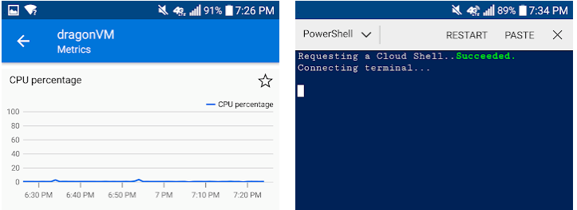
Azure Mobile App
Stay connected to the cloud
Check status and critical metrics anytime, anywhere
Diagnose and fix issues quickly
Run commands to manage your Azure resources

Slide 8
Azure Cloud Shell
Interactive, browser-accessible shell
Offers either Bash or PowerShell
Is temporary and provided on a per-session, per-user basis
Requires a resource group, storage account, and Azure File share
Authenticates automatically
Integrated graphical text editor
Is assigned one machine per user account
Times out after 20 minutes

Slide 9
Lesson 02: Azure PowerShell and CLI

Slide 10
Azure PowerShell and CLI Overview
PowerShell Cmdlets and Modules
Azure PowerShell
Demonstration – Working with PowerShell Locally
Azure CLI
Demonstration – Working with Azure CLI Locally
Notes:
Lesson overview

Slide 11
Azure PowerShell
New-AzVm `
-ResourceGroupName "CrmTestingResourceGroup" `
-Name "CrmUnitTests" `
-Image "UbuntuLTS" `
...
Lets you connect to your Azure subscription and manage resources
Adds the Azure-specific commands – new Az module
Available inside a browser via the Azure Cloud Shell
Available as a local installation on Linux, macOS, or Windows
Has an interactive and a scripting mode

Slide 12
Demonstration – Working with PowerShell Locally
In this demonstration, we will install Azure Az PowerShell module locally and try a few cmdlets
Launch PowerShell locally
Install the Az module
Connect to Azure and view your subscription information
Create resources
Notes:
✔ Always consider having students walk-through the demonstrations themselves. Also, consider the overlap with the formal labs and your best use of time.

Slide 13
Azure CLI
az vm restart -g MyResourceGroup -n MyVm
Cross-platform command-line program
Runs on Linux, macOS, and Windows
Can be used interactively or through scripts
Commands are structured in _groups_ and _subgroups_
Use find to locate commands
Use --help for more detailed information

Slide 14
Demonstration – Working with the CLI
In this demonstration, we will install and use the CLI locally
Install the CLI
Verify the installation
Login to Azure
Create a resource group
Verify the resource group
Notes:
✔ Always consider having students walk-through the demonstrations themselves. Also, consider the overlap with the formal labs and your best use of time.

Slide 15
Lesson 03: Resource Manager

Slide 16
Resource Manager Overview
Resource Manager
Terminology
Resource Group Deployments
Resource Manager Locks
Moving Resources
Removing Resources and Resource Groups
Demonstration- Resource Groups
Notes:
Lesson overview

Slide 17
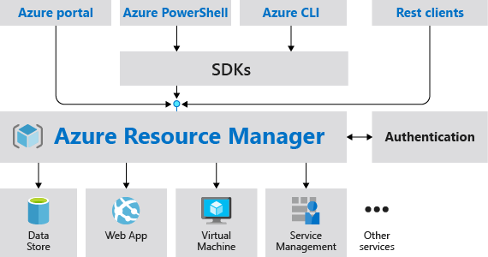
Resource Manager
Provides a consistent management layer
Enables you to work with the resources in your solution as a group
Deploy, update, or delete in a single, coordinated operation
Provides security, auditing, and tagging features
Choose the tools and APIs that work best for you

Slide 18
Terminology
A resource is simply a single service instance in Azure
A resource group is a logical grouping of resources
An Azure resource manager template is a JSON file that allows you to declaratively describe a set of resources
A declarative syntax is what a template uses to state what you intend to create
A resource provider is service that supplies the resources you can deploy and manage through Resource Manager

Slide 19
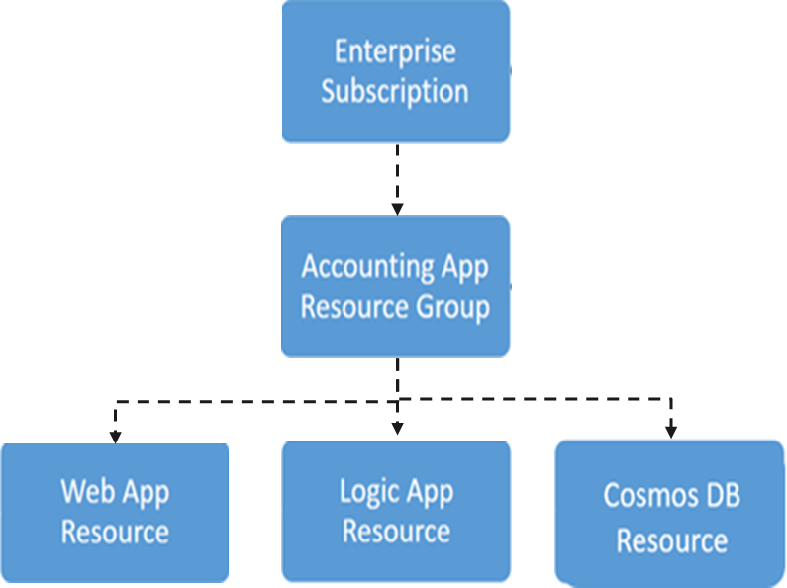
Resource Groups and Deployments
Resources can only exist in one resource group
Groups cannot be renamed
Groups can have resources of many different types (services)
Groups can have resources from many different regions
Deployments are incremental
✔️ By scoping permissions to a resource group, you can add/remove and modify resources easily

Slide 20
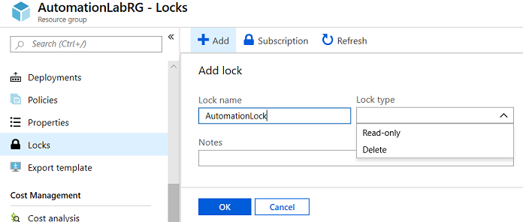
Resource Manager Locks
Associate the lock with a subscription, resource group, or resource
Locks are inherited by child resources
Read-Only locks prevent any changes to the resource
Delete locks prevent deletion
Notes:
✔ Only Owner and User Access Administrator roles can create or delete management locks.
For additional information, see:
Lock resources to prevent unexpected changes: https://docs.microsoft.com/en-us/azure/azure-resource-manager/resource-group-lock-resources

Slide 21
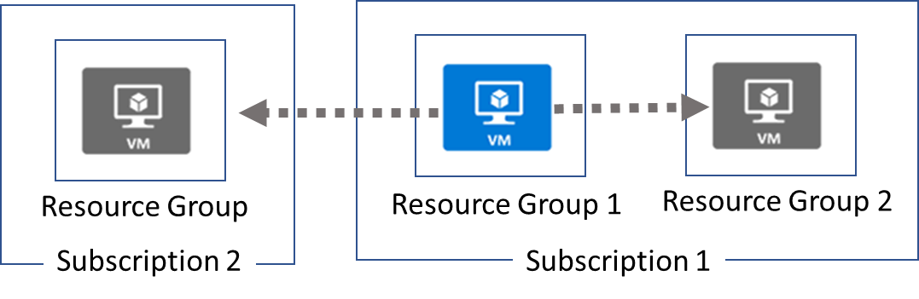
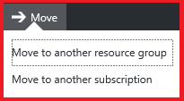
Moving Resources
When moving resources, both the source group and the target group are locked during the operation
Services that cannot be moved: AD Domain Services, ExpressRoute, and Site Recovery
Notes:
✔ Just because a service can be moved doesn’t mean there aren’t restrictions. For example, you can move a virtual network, but you must also move its dependent resources, like gateways. Learn more at the reference link.
For more information, you can see:
Move resources to new resource group or subscription - https://docs.microsoft.com/en-us/azure/azure-resource-manager/resource-group-move-resources

Slide 22
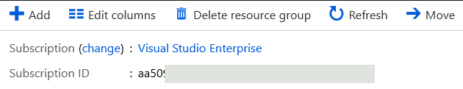
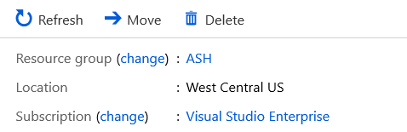
Removing Resources and Resource Groups
Resource Groups
Remove-AzResourceGroup -Name "ContosoRG01"
Resources
Remove-AzResource -ResourceId <ResourceID>

Slide 23
Demonstration – Resource Groups
In this demonstration, we will create and delete resource locks
Manage resource groups in the portal
Manage resource groups with PowerShell
Notes:
✔ Always consider having students walk-through the demonstrations themselves. Also, consider the overlap with the formal labs and your best use of time.

Slide 24
Lesson 04: ARM Templates

Slide 25
ARM Templates Overview
Template Advantages
Template Schema
Template Parameters
Template Variables
QuickStart Templates
Demonstration – QuickStart Templates
Demonstration – Run Templates with PowerShell

Slide 26
Template Advantages
Improves consistency
Express complex deployments
Reduce manual, error prone tasks
Express requirements through code
Promotes reuse
Modular and can be linked
Simplifies orchestration
ARM
Template
Development
Production
Quality
Assurance
Notes:
Use the same template across deployments so the resources are identical.

Slide 27
Template Schema
{
"$schema": "http://schema.management.
azure.com/schemas/2015-01- 01/deploymentTemplate.json#",
"contentVersion": "",
"parameters": { },
"variables": { },
"functions": [ ],
"resources": [ ],
"outputs": { }
}
Defines all the Resource Manager resources in a deployment
Written in JSON
A collection of key-value pairs
Each key is a string
Each values can be a string, number, Boolean expression, list of values, object

Slide 28
Template Parameters
"parameters": {
"adminUsername": {
"type": "string",
"metadata": {
"description": "Username for the Virtual Machine."
}
},
"adminPassword": {
"type": "securestring",
"metadata": {
"description": "Password for the Virtual Machine."
}
}
}
Specify which values are configurable when the template runs
This example has two parameters: one for a VM’s username (adminUsername), and one for its password (adminPassword)

Slide 29
Template Variables
Define values that are used throughout the template
Makes your templates easier to maintain
This example provides variables that describe networking features for a virtual machine
"variables": {
"nicName": "myVMNic",
"addressPrefix": "10.0.0.0/16",
"subnetName": "Subnet",
"subnetPrefix": "10.0.0.0/24",
"publicIPAddressName": "myPublicIP",
"virtualNetworkName": "MyVNET"
}

Slide 30
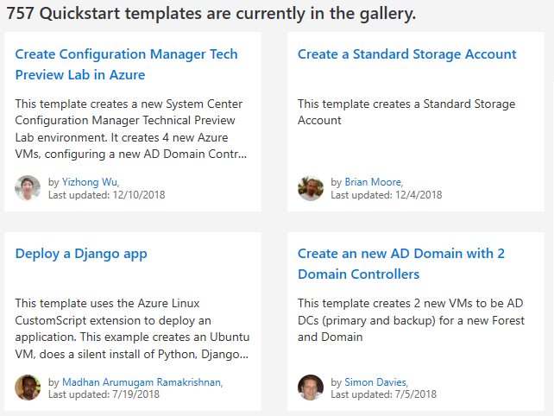
QuickStart Templates
Resource Manager templates provided by the Azure community
Provides everything you need to deploy your solution or serves as a starting point for your template
https://azure.microsoft.com/en-us/resources/templates/
Notes:
https://azure.microsoft.com/en-us/resources/templates/

Slide 31
Demonstration – QuickStart Templates
In this demonstration, you will explore QuickStart templates
Explore the QuickStart gallery
Explore a template
Notes:
✔ Always consider having students walk-through the demonstrations themselves. Also, consider the overlap with the formal labs and your best use of time.

Slide 32
Demonstration – Run Templates with PowerShell
In this demonstration, you will create new Azure resources using PowerShell and Resource Manage templates
Connect to your subscription
Create the resource group
Deploy the template into the resource group
Verify the template deployed
Notes:
✔ Always consider having students walk-through the demonstrations themselves. Also, consider the overlap with the formal labs and your best use of time.

Slide 33
AZ-103T00A Module 02: Azure Virtual Machines
Notes:
There are two possible labs in this module. The Virtual Machines and Scale Sets lab has setup time. If you are going to do that lab, consider completing Exercise 0: Prepare the lab environment before starting the lecture.

Slide 34
Module Overview
Virtual Machine Planning
Creating Virtual Machines
Virtual Machine Availability
Virtual Machine Extensions
Lab and Review Questions
Notes:
Module overview

Slide 35
Lesson 01: Virtual Machine Planning

Slide 36
Virtual Machine Planning Overview
IaaS Cloud Services
Planning Checklist
Location and Pricing
Virtual Machine Sizing
Virtual Machine Disks
Storage Options
Supported Operating Systems
Notes:
Lesson overview

Slide 37
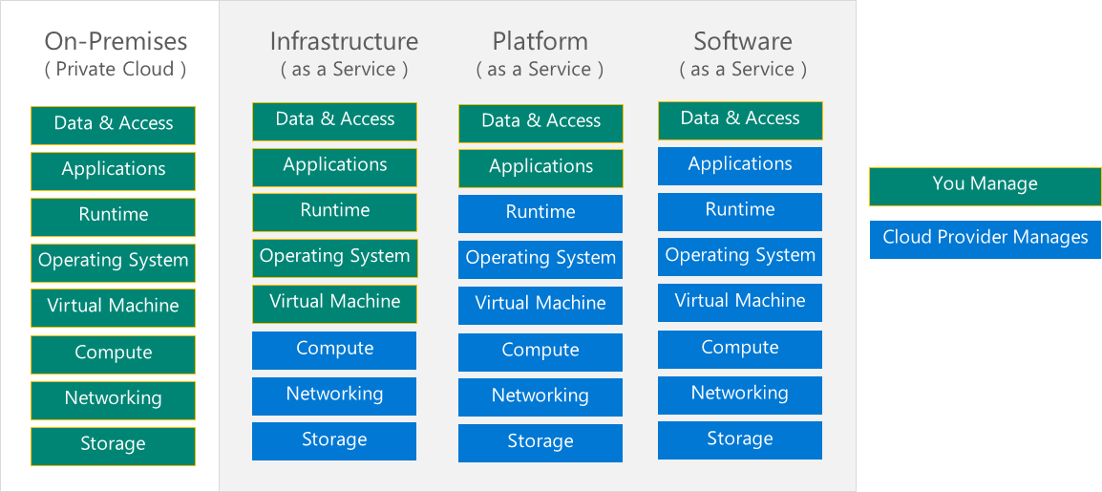
IaaS Cloud Services
Test and development, website hosting, storage, backup, recovery, high-performance computing, big data analysis, and extended data center
Notes:
For more information, you can see:
Infrastructure as a Service - https://azure.microsoft.com/en-us/overview/what-is-iaas/

Slide 38

Azure virtual machine planning checklist
Before you create a virtual machine (VM), you should consider the following:
Checklist
Network configuration
VM name
Location
Size
Pricing model
Storage
Operating system
Notes:
Provisioning VMs to Azure requires planning. The items listed above only provides a subset of the things one should consider before creating a VM.

Slide 39
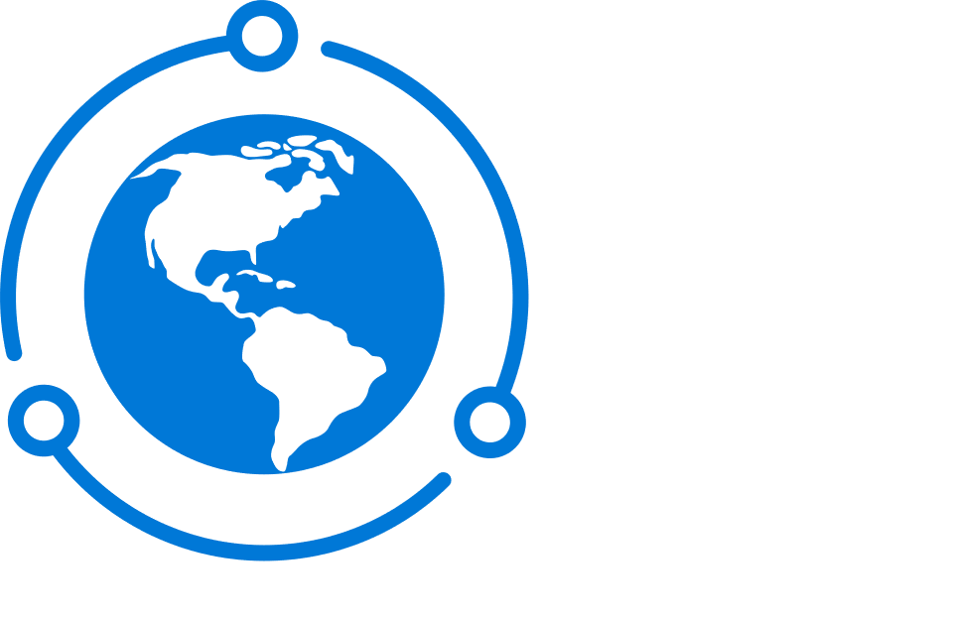
Location
Location
Each region has different hardware and service capabilities
Locate virtual machines as close as possible to your users
Locate virtual machines to ensure compliance and legal obligations
54 Azure regions
Available in 140 countries

Slide 40
VM pricing models
Two primary costs for every VM:
Storage – The cost of storing data in every virtual hard disk. This cost is independent of whether the VM is running
Compute – The usage-based price for compute capacity when the VM is currently allocated
There are two payment options for compute costs:
Pay as you go – Compute capacity is billed and paid as it is used without a long-term commitment
Reserved instances – Compute capacity can be pre-purchased at a reduced rate for anticipated usage
Notes:
There are two separate costs the subscription will be charged for every VM: compute and storage. By separating these costs, you scale them independently and only pay for what you need.
Compute costs – Compute expenses are priced on a per-hour basis but billed on a per-minute basis. For example, you are only charged for 55 minutes of usage if the VM is deployed for 55 minutes. You are not charged for compute capacity if you stop and deallocate the VM because this releases the hardware. The hourly price varies based on the VM size and OS you select. The cost for a VM includes the charge for the Windows operating system. Linux-based instances are less expensive because there is no operating system license charge.
Storage costs – You are charged separately for the storage the VM uses. The status of the VM has no relation to the storage charges that will be incurred; even if the VM is stopped/deallocated and you aren’t billed for the running VM, you will be charged for the storage used by the disks.
Pay as you go – With the pay-as-you-go option, you pay for compute capacity by the second, with no long-term commitment or upfront payments. You're able to increase or decrease compute capacity on demand and start or stop at any time. Prefer this option if you run applications with short-term or unpredictable workloads that cannot be interrupted. For example, if you are doing a quick test, or developing an app in a VM, this would be the appropriate option.
Reserved Virtual Machine Instances – The Reserved Virtual Machine Instances (RI) option is an advance purchase of a virtual machine for one or three years in a specified region. The commitment is made up front, and in return, you get up to 72% price savings compared to pay-as-you-go pricing. RIs are flexible and can easily be exchanged or returned for an early termination fee. Prefer this option if the VM must run continuously, or if you need budget predictability and you can commit to using the VM for at least a year.

Slide 41
VM configuration options
Computational performance
1 virtual CPU (vCPU) - 128 vCPUs
Memory
1 gibibyte (GiB) - 4 tebibyte (TiB)
Disk storage
4GiB - 64TiB
Up 160,000 IOPs
Networking
30 GB Ethernet 100 GB InfiniBand
Availability
Single VM service-lvel agreement (SLA) 99.9% Multi AZ SLA 99.99%
Notes:
The size of the VM that you use is determined by the workload that you want to run. The size that you choose then determines factors such as processing power, memory, and storage capacity. Azure offers a wide variety of sizes to support many types of uses.
Each size provides a range of configuration options to support various workloads that may possibly run in Azure.

Slide 42
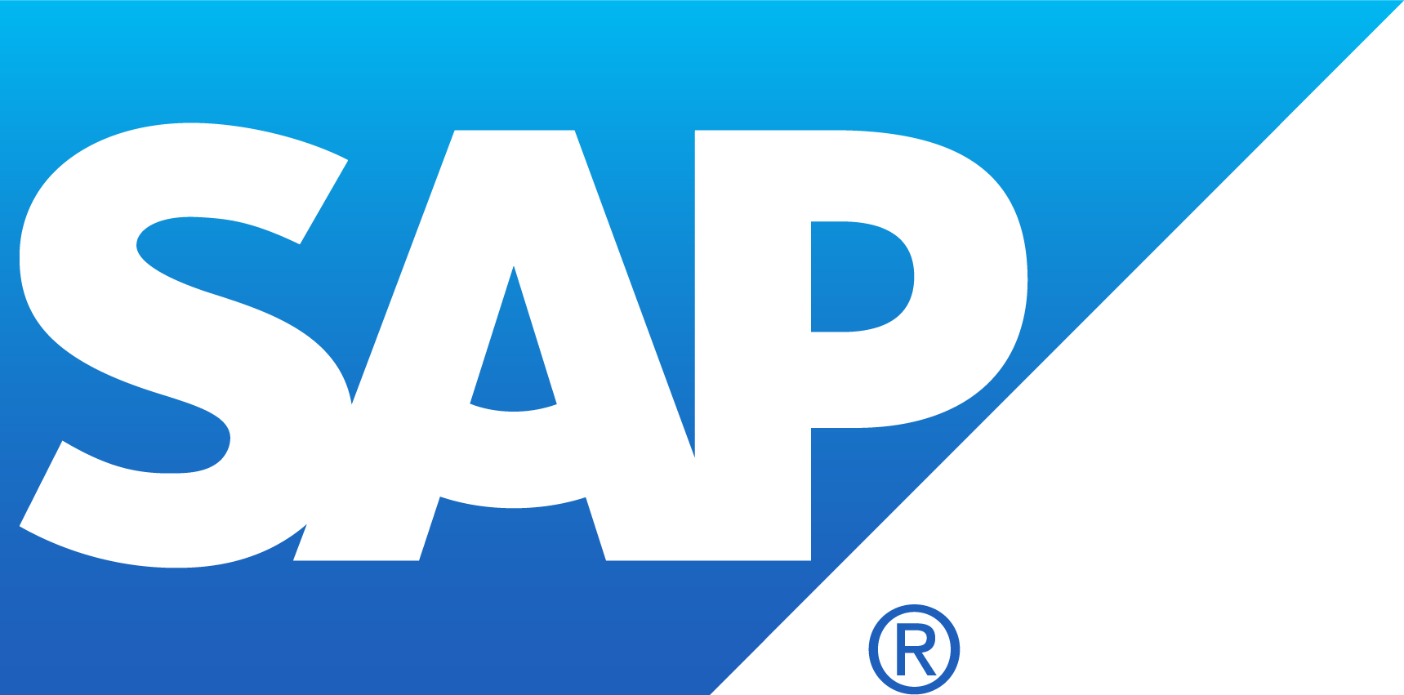
VM categories
Virtual machines
Purpose built
Entry level
Burstable
General purpose
Compute intensive
Memory optimized
GPU accelerated
High performance computing
Storage optimized
Notes:
You can design Azure Virtual Machines for a wide variety of workloads, starting from economical entry-level virtual machines to high-performance virtual machines for specialized workloads.
There are multiple categories listed here including:
Entry level. Economical, low-cost virtual machines for workloads that normally don't use a lot of CPU, but occasionally need to burst to handle higher workloads.
Burstable. Designed for workloads that will run for a long time by using a small fraction of the allocated CPU performance and then spike to the full power of the CPU due to incoming traffic or required work.
General purpose. Balanced CPU-to-memory ratio. Ideal for testing and development, small to medium databases, and low to medium traffic web servers.
Compute intensive. High CPU-to-memory ratio. Good for medium traffic web servers, network appliances, batch processes, and application servers.
Memory optimized. High memory-to-CPU ratio. Great for relational database servers, medium to large caches, and in-memory analytics.
GPU accelerated. Specialized virtual machines targeted for heavy graphic rendering and video editing as well as model training and inferencing (ND) with deep learning. Available with single or multiple GPUs.
High performance computing. Fastest and most powerful CPU virtual machines with optional high-throughput network interfaces (RDMA).
Storage optimized. High disk throughput and IO ideal for Big Data, SQL, NoSQL databases, data warehousing, and large transactional databases.

Slide 43
Virtual Machine Sizing
VM Type | Sizes | Purpose
General Purpose | B, Dsv3, Dv3, DSv2, Dv2, Av2, DC | Testing and development, small to medium databases, and low to medium traffic web servers.
Compute Optimized | Fsv2, Fs, F | Medium traffic web servers, network appliances, batch processes, and application servers.
Memory Optimized | Esv3, Ev3, M, GS, G, DSv2, Dv2 | Relational database servers, medium to large caches, and in-memory analytics.
Storage Optimized | Lsv2, Ls | Ideal for VMs running databases.
GPU | NV, NVv2, NC, NCv2, NCv3, ND, NDv2 (Preview) | Ideal for model training and inferencing with deep learning.
High Performance Compute | H | Fastest and most powerful CPU virtual machines with optional high-throughput network interfaces.
Notes:
✔️ Be cautious when resizing production VMs - they will be rebooted automatically which can cause a temporary outage and change some configuration settings such as the IP address.
For more information, you can see:
Sizes for Windows virtual machines in Azure - https://docs.microsoft.com/en-us/azure/virtual-machines/windows/sizes?toc=%2Fazure%2Fvirtual-machines%2Fwindows%2Ftoc.json#size-tables
Sizes for Linux virtual machines in Azure - https://docs.microsoft.com/en-us/azure/virtual-machines/linux/sizes?toc=%2fazure%2fvirtual-machines%2flinux%2ftoc.json

Slide 44
Storage Options
Premium storage offers high-performance, low-latency SSD disk support
Use premium storage for virtual machines with input/output (I/O)-intensive workloads
Notes:
✔ For the best performance for your application, we recommend that you migrate any VM disk that requires high IOPS to Premium Storage. If your disk does not require high IOPS, you can help limit costs by keeping it in standard Azure Storage. In standard storage, VM disk data is stored on hard disk drives (HDDs) instead of on SSDs.

Slide 45
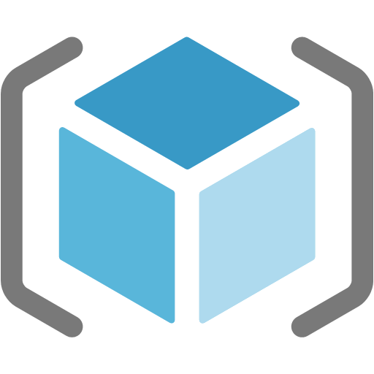


Managed and unmanaged disks
Managed disks
The Azure platform manages the disk and the backing storage
You don't have to worry about storage account limits and thresholds
Unmanaged disks
You manually create and manage virtual hard disks (VHDs) in your Storage account
You will need to consider account throughput and capacity limits when using this model
Storage
Unmanaged disks
Resource Group
Managed disk
Managed disk
Notes:
Managed disks. Managed disks are the newer and recommended disk storage model. They elegantly solve this complexity by putting the burden of managing the storage accounts onto Azure. You specify the size of the disk, which can be up to 4 terabytes (TB), and Azure creates and manages both the disk and the storage. You don't have to worry about storage account limits, which makes managed disks easier to scale out than managed discs.
Unmanaged disks. With unmanaged disks, you’re responsible for the storage accounts that hold the virtual hard disks (VHDs) that correspond to your VM disks. You pay the storage account rates for the amount of space you use. A single storage account has a fixed-rate limit of 20,000 input/output (I/O) operations per second. This means that a storage account is capable of supporting 40 standard VHDs at full utilization. If you need to scale out with more disks, then you'll need more storage accounts, which can get complicated.

Slide 46
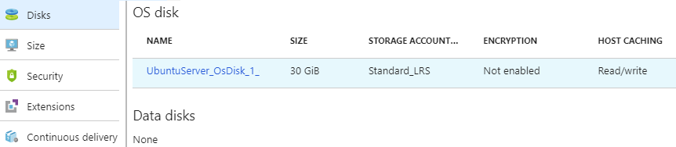
Virtual Machine Disks
Operating System Disks are SATA drives, labeled as C:
Temporary Disks provides short term storage
Data Disks are SCSI drives and depend on your virtual machine type
Notes:
✔️ Don’t store data on the temporary disk. It provides temporary storage for applications and processes and is intended to only store data such as page or swap files.

Slide 47
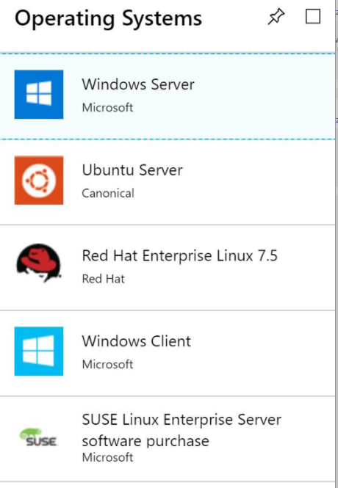
Supported Operating Systems
Windows Server includes many common products, requires a license, doesn’t support OS upgrades
Linux distributions are supported, upgrade of the OS is supported
Notes:
For more information, you can see:
Microsoft server software support for Microsoft Azure virtual machines - https://support.microsoft.com/en-us/help/2721672/microsoft-server-software-support-for-microsoft-azure-virtual-machines
Linux on distributions endorsed by Azure - https://docs.microsoft.com/en-us/azure/virtual-machines/linux/endorsed-distros#supported-distributions–versions.

Slide 48
Lesson 02: Creating Virtual Machines

Slide 49
Creating Virtual Machines Overview
Creating Virtual Machines in the Portal
Windows Virtual Machines
Windows VM Connections
Demonstration – Creating a VM in the Portal
PowerShell – Example (Part 1)
PowerShell – Example (Part 2)
Demonstration – Creating a Virtual Machine with PowerShell
Linux Virtual Machines
Linux VM Connections
Demonstration – Connect to Linux Virtual Machines
Notes:
Lesson overview

Slide 50

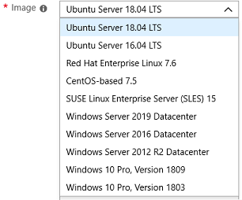
Creating Virtual Machines in the Portal
Basic (required) - Project details, Administrator account, Inbound port rules
Disks - OS disk type, data disks
Networking - Virtual networks, load balancing
Management - Monitoring, Auto-shutdown, Backup
Guest config - Add additional configuration, agents, scripts or applications

Slide 51
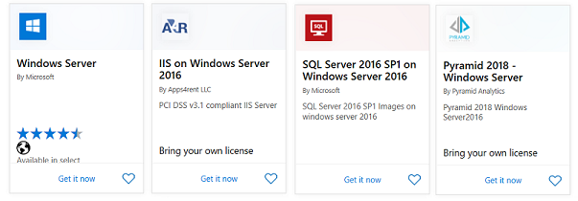
Windows Virtual Machines
Unique hybrid capabilities
Advanced multi-layer security
Faster innovation for applications
Unprecedented hyper-converged infrastructure
Notes:
Windows Virtual Machines Documentation - https://docs.microsoft.com/en-us/azure/virtual-machines/windows/

Slide 52
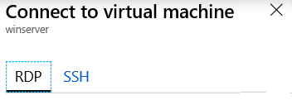
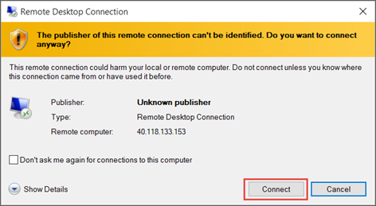
Windows VM Connections
Remote Desktop Protocol (RDP) creates a GUI session and accepts inbound traffic on TCP port 3389
WinRM creates a command-line session so can run scripts

Slide 53
Demonstration – Create a VM in the Portal
Create the virtual machine
Connect to the virtual machine
Install the Web Server role
View the IIS welcome page
Notes:
✔ Always consider having students walk-through the demonstrations themselves. Also, consider the overlap with the formal labs and your best use of time.

Slide 54
PowerShell - Example (Part 1)
1 - Get administrator credentials
2 -Create the initial virtual machine configuration
3 - Add the OS information
Add the image information
Create the virtual machine
# 1. Set the admin credentials (username and pwd)
$cred = Get-Credential
# 2. Create the initial virtual machine configuration
$vm = New-AzVMConfig -VMName myVM -VMSize Standard_D1
# 3. Add the OS information
$vm = Set-AzVMOperatingSystem -VM $vm -Windows -ComputerName myVM -Credential $cred -ProvisionVMAgent -EnableAutoUpdate
Notes:
Steps continue on the next page.

Slide 55
PowerShell - Example (Part 2)
Get administrator credentials
Create the initial virtual machine configuration
Add the OS information
4 - Add the image information
5 - Create the virtual machine
# 4. Add the image information
$vm = Set-AzVMSourceImage -VM $vm -PublisherName MicrosoftWindowsServer -Offer WindowsServer -Skus 2016-Datacenter –Version "latest"
# 5. Create the VM
New-AzVm -ResourceGroupName "myResourceGroup" -Name "myVM" -Location "East US" -VirtualNetworkName "myVnet" -SubnetName "mySubnet" -SecurityGroupName "myNetworkSecurityGroup" -PublicIpAddressName "myPublicIpAddress"-OpenPorts 80,3389
Notes:
This code has been changed to remove virtual network settings which have not been covered yet. The Create the VM code matches what will be shown in the demonstration.

Slide 56
Demonstration – Creating a VM with PowerShell
Create the virtual machine with PowerShell
Verify the machine creation in the portal
Connect to the virtual machine
Notes:
✔ Always consider having students walk-through the demonstrations themselves. Also, consider the overlap with the formal labs and your best use of time.

Slide 57
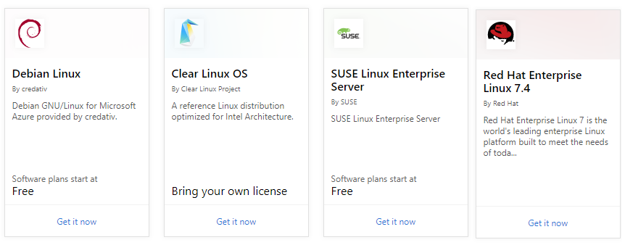
Linux Virtual Machines
Hundreds of community-built images in the Azure Marketplace
Linux has the same deployment options as for Windows VMs
Manage Linux VMs with many popular open-source DevOps tools
Notes:
Linux virtual machines (Documentation) - https://docs.microsoft.com/en-us/azure/virtual-machines/linux/

Slide 58
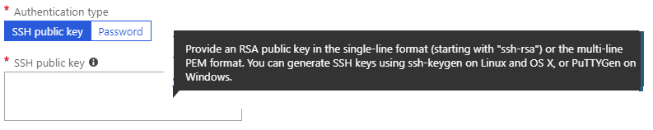
Linux VM Connections
Authenticate with a SSH public key or password
SSH is an encrypted connection protocol that allows secure logins over unsecured connections
There are public and private keys
Notes:
✔️ Azure currently requires at least a 2048-bit key length and the SSH-RSA format for public and private keys.

Slide 59
Demonstration – Connect to Linux VMs
Create the SSH keys
Create the Linux machine and assign the public SSH key
Access the server using SSH
Notes:
✔ Always consider having students walk-through the demonstrations themselves. Also, consider the overlap with the formal labs and your best use of time.

Slide 60
Lesson 03: Virtual Machine Availability

Slide 61
Virtual Machine Availability Overview
Maintenance and Downtime
Availability Sets
Update and Fault Domains
Availability Zones
Scale Sets
Implementing Scale Sets
Autoscale
Implementing Autoscale
Notes:
Lesson overview

Slide 62
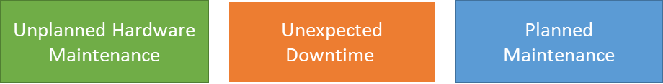
Maintenance vs. Downtime
When the platform predicts a failure, it will issue an unplanned hardware maintenance event. Action: Live migration.
Unexpected Downtime is when a virtual machine fails unexpectedly. Action: Automatically migrate (heal).
Planned Maintenance events are periodic updates made to the Azure platform. Action: No action.
Notes:
✔️ To reduce the impact of downtime due to one or more of these events, we recommend placing multiple virtual machines into an availability set (next topic).

Slide 63
High availability and disaster recovery
Higher Latency
Region 1
Region 2
Region pairs
Protection from disaster with Data Residency compliance
Availability zones
Protection from entire datacenter failures
Availability sets / VM Scale Sets
Protection against failures within datacenters
Increased resiliency
Notes:
An availability set is a logical grouping of VMs within a datacenter that allows Azure to understand how your application is built to provide for redundancy and availability. Two or more VMs should be created within an availability set to provide for a highly available application and to meet the 99.95% Azure SLA. An availability set is composed of two additional groupings that protect against hardware failures and allow updates to safely apply—fault domains (FDs) and update domains (UDs).
Availability zones are alternatives to availability sets and expand the level of control you have over maintaining the availability of the applications and data on your VMs. An availability zone is a physically separate zone within an Azure region. There are three availability zones per supported Azure region. Each availability zone has a distinct power source, network, and cooling. By architecting your solutions to use replicated VMs in zones, you can protect your apps and data from the loss of a datacenter. If one zone is compromised, then replicated apps and data are instantly available in another zone.
Each Azure region is paired with another region within the same geography (such as US, Europe, or Asia), together making a region pair. This approach allows for the replication of resources, such as VM storage, across a geography. This should reduce the likelihood of natural disasters, civil unrest, power outages, or physical network outages affecting availability.

Slide 64
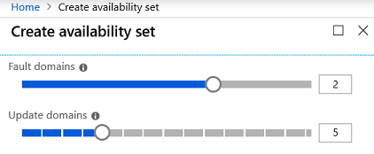
Availability Sets
Two or more instances in two or more availability zones = 99.99% uptime
Configure multiple virtual machines in an Availability Set
Configure each application tier into separate Availability Sets
Combine a Load Balancer with Availability Sets
Use managed disks with the virtual machines
Notes:
✔️ You can create a virtual machine and an availability set at the same time. A VM can only be added to an availability set when it is created. To change the availability set, you need to delete and then recreate the virtual machine.

Slide 65
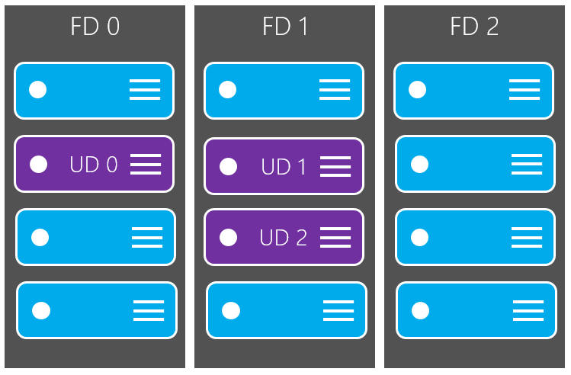
Update domain
Update domains lets Azure to perform incremental or rolling upgrades across a deployment. During planned maintenance, only one update domain is rebooted at a time.
Notes:
✔️ Placing your virtual machines into an availability set does not protect your application from operating system or application-specific failures, it does limit the impact of potential physical hardware failures, network outages, or power interruptions. Can you see why this important and how this is implemented?

Slide 66

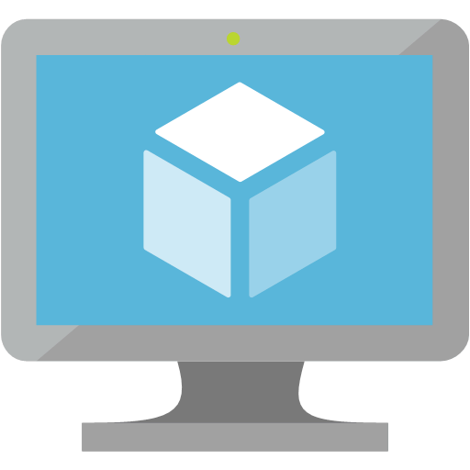

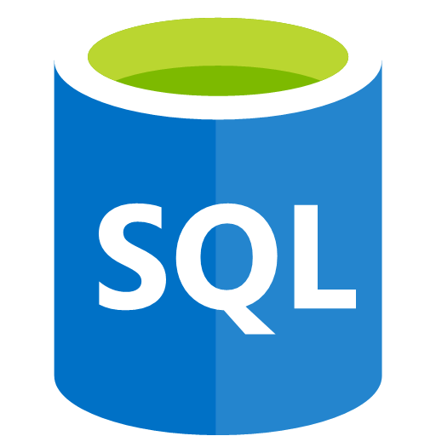
Fault domains
Fault domain – a logical group of hardware in Azure that shares a common power source and network switch
Fault domain
Fault domain
Rack
Rack
Virtual machine
Availability
set
Virtual machine
IIS1
IIS2
Virtual machine
Availability
set
Virtual machine
SQL1
SQL2
Notes:
What is a fault domain?
A fault domain is a logical group of hardware in Azure that shares a common power source and network switch. You can think of it as a rack within an on-premises datacenter. The first two VMs in an availability set will be provisioned into two different racks so that if the network or the power failed in a rack, only one VM would be affected. Fault domains are also defined for managed disks attached to VMs.

Slide 67
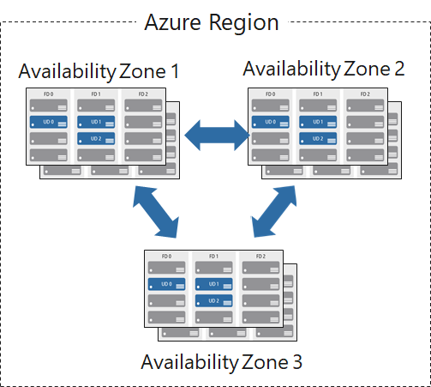
Availability Zones
Unique physical locations in a region
Includes datacenters with independent power, cooling, and networking
Protects from datacenter failures
Combines update and fault domains

Slide 68
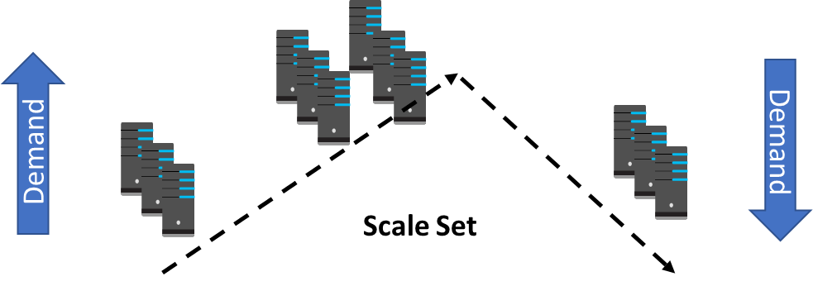
Scale Sets
Scale sets deploy a set of identical VMs
No pre-provisioning of VMs is required
As demand goes up VMs are added
As demand goes down VM are removed
The process can be manual, automated, or a combination of both

Slide 69
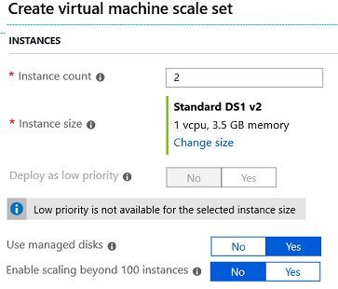
Implementing Scale Sets
Instance count. Number of VMs in the scale set (0 to 1000)
Instance size. The size of each virtual machine in the scale set
Deploy as low priority. Can save up to 80%
Use managed disks
Enable scaling beyond 100 instances

Slide 70
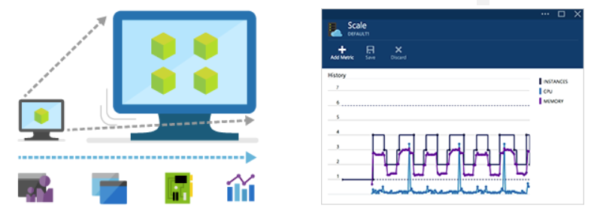
Autoscale
Define rules to automatically adjust capacity
Scale out (increase) the number of VMs in the set
Scale in (reduce) the number of VMs in the set
Schedule events to increase or decrease at a fixed time
Reduces monitoring and optimizes performance
Notes:
✔️ Autoscale minimizes the number of unnecessary VM instances that run your application when demand is low, while customers continue to receive an acceptable level of performance as demand grows and additional VM instances are automatically added.

Slide 71
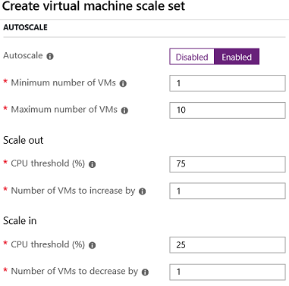
Implementing Autoscale
Define a minimum, maximum, and default number of VM instances
Create more advanced scale sets with scale out and scale in parameters
Notes:
For more information, you can see:
Best Practices for Autoscale - https://docs.microsoft.com/en-us/azure/monitoring-and-diagnostics/insights-autoscale-best-practices

Slide 72
Lesson 04: Virtual Machine Extensions

Slide 73
Virtual Machine Extensions Overview
Virtual Machine Extensions
Custom Script Extensions
Desired State Configuration
Demonstration – Custom Script Extension
Notes:
Lesson overview

Slide 74
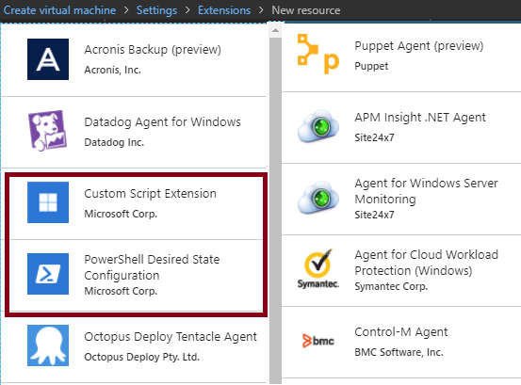
Virtual Machine Extensions
Extensions are small applications that provide post-deployment VM configuration and automation tasks
Managed with Azure CLI, PowerShell, Azure Resource Manager templates, and the Azure portal
Bundled with a new VM deployment or run against any existing system
Different for Windows and Linux machines.
Notes:
✔️ In this lesson we will focus on two extensions: Custom Script Extensions and Desired State Configuration. Both tools are based on PowerShell.
For more information, you can see:
Virtual machine extensions and features for Windows - https://docs.microsoft.com/en-us/azure/virtual-machines/extensions/features-windows?toc=%2Fazure%2Fvirtual-machines%2Fwindows%2Ftoc.json
Virtual machine extensions and features for Linux - https://docs.microsoft.com/en-us/azure/virtual-machines/extensions/features-linux

Slide 75
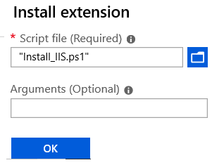
Custom Script Extensions
Extension scripts can be simple or complex
Extensions have 90 minutes to run
Double check dependencies to ensure availability
Account for any errors that might occur
Protect/encrypt sensitive information
✔️ For PowerShell use the Set-AzVmCustomScriptExtension command
Notes:
✔ Can you think of any custom script extensions that you might want to create?

Slide 76
Desired State Configuration
Configuration block(s) have a name
Node blocks define the computers or VMs that you are configuring
Resource block(s) configure the resource and it’s properties
There are many built-in configuration resources
configuration IISInstall
{
Node “localhost”
{
WindowsFeature IIS
{
Ensure = “Present”
Name = “Web-Server”
}
}
}
Notes:
✔️ The Windows PowerShell DSC comes with a set of built-in configuration resources. For example, File Resource, Log Resource, and User Resource. Use the reference link to view the resources that are available to you. Are there any resources that you might be interested in? Take a few minutes to discuss the resources and configuration parameters.

Slide 77
Demonstration – Custom Script Extension
Run a PowerShell script to install the Web Server role on a virtual machine
Notes:
✔ Always consider having students walk-through the demonstrations themselves. This is not covered in the lab.

Slide 78
Lesson 05: Labs and Review Questions

Slide 79
Lab - Deploy and Manage Virtual Machines
Adatum Corporation wants to implement its workloads by using Azure virtual machines (VMs) and Azure VM scale sets.
Exercise 1. Deploy Azure VMs by using the Azure portal, Azure PowerShell, and Azure Resource Manager templates
Exercise 2. Configure networking settings of Azure VMs running Windows and Linux operating systems
Exercise 3. Deploy and configure Azure VM scale sets
Lab time: 60 minutes
Notes:
You may want to make Exercise 2 optional, since networking has not yet been covered.

Slide 80
Module Review Questions + other
Notes:
As you have time go through the Module Review questions in the student materials.

Slide 81
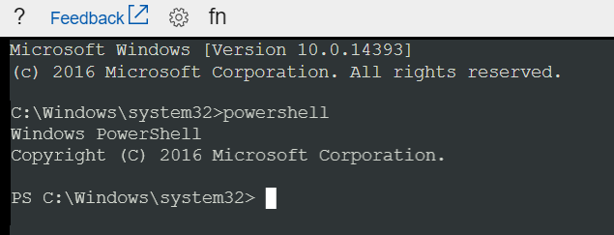
VM Serial Console
Console access to a VM independent of network or OS state
Available in Linux or Windows
Bash, CMD, PowerShell, NMI, SysRq, vi, GRUB, etc…
Notes:
The Serial Console in the Azure portal provides access to a text-based console for virtual machines (VMs). This serial connection connects to the ttys0 serial port for Linux VMs and COM1 serial port for Windows VMs.
The Serial Console provides access to the VM independent of the network or operating system state. The serial console can only be accessed by using the Azure portal.

Slide 82
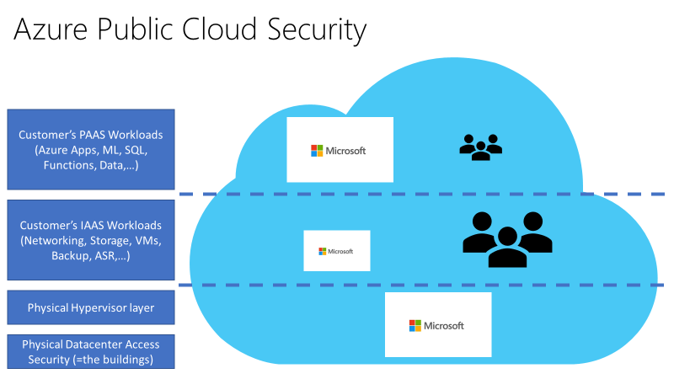
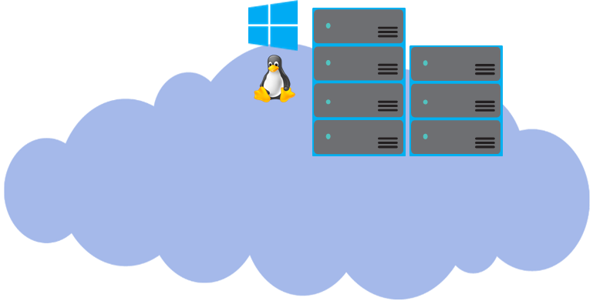
Cloud Platform Security
- Each Azure Tenant is isolated from all other tenants, using “Azure Fabric Controller”
- Azure datacenters are mainly based on Microsoft proprietary hardware, running an Azure-host-specific version of Hyper-V
Customer A
Customer B
Notes:
20535A
9: Managing Security & Identity for Azure Solutions

Slide 83

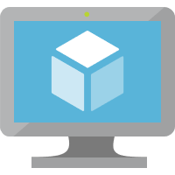


Capturing performance diagnostics for a VM
Report
VM
Azure Portal
Run PerfInsights
Notes:
The performance diagnostics tool helps you troubleshoot performance issues that can affect a Windows VM. Supported troubleshooting scenarios include quick checks on known issues and best practices, and complex problems that involve slow VM performance or high usage of CPU, disk space, or memory. You can run performance diagnostics directly from the Azure portal, where you can also review insights and a report on various logs, rich configuration, and diagnostics data. Performance diagnostics installs a VM extension that runs a diagnostics tool that is named PerfInsights.

Slide 84



Recovering a failed VM by using a rescue VM
STOP
START
Snapshot
Failed VM
Rescue VM
Notes:
If an Azure VM is inaccessible, it may be necessary to attach the operating system (OS) disk to another Azure VM to perform the recovery steps.
To perform a recovery, you must:
Stop the failed VM.
Take a snapshot of the failed VM's OS disk.
Create a new temporary VM (rescue VM).
Attach the failed VM's OS disk as a data disk on the rescue VM.
Connect to the rescue VM to investigate and mitigate issues with the failed VM's OS disk.
Detach the failed VM's OS disk from the rescue VM.
Perform a disk swap to swap the failed VM's OS disk from the rescue VM back to the failed VM.
Remove the resources that were created for the rescue VM.

Slide 85
Create an Azure VM by using PowerShell
Connect-AzAccount
New-AzResourceGroup -Name myResourceGroup -Location EastUS
New-AzVm `
-ResourceGroupName "myResourceGroup" `
-Name "myVM" `
-Location "East US" `
-VirtualNetworkName "myVnet" `
-SubnetName "mySubnet" `
-SecurityGroupName "myNetworkSecurityGroup" `
-PublicIpAddressName "myPublicIpAddress" `
-OpenPorts 80,3389
Notes:
The Azure PowerShell module is used to create and manage Azure resources from the PowerShell command line or in scripts.
Launch Azure Cloud Shell
If you choose to install and use the PowerShell locally, this tutorial requires the new Az Azure PowerShell module version 1.0 (or later). Run Get-Module -ListAvailable Az* to find the version, you also need to run Connect-AzAccount to create a connection with Azure.
Create resource group
Create an Azure resource group with New-AzResourceGroup. A resource group is a logical container into which Azure resources are deployed and managed.
Create a virtual machine
Create a VM with New-AzVM. Provide names for each of the resources and the New-AzVM cmdlet creates if they don't already exist.

Slide 86
Accessing an Azure VM by using PowerShell
Get-AzPublicIpAddress -ResourceGroupName "myResourceGroup" | Select "IpAddress“
mstsc /v:publicIpAddress
Install-WindowsFeature -name Web-Server –IncludeManagementTools
Notes:
The Azure PowerShell module is used to create and manage Azure resources from the PowerShell command line or in scripts.
Connect to virtual machine
After the deployment has completed, RDP to the VM. To examine the public IP address of the VM, use the Get-AzPublicIpAddress cmdlet. Create a remote desktop session from your local computer. Replace the IP address with the public IP address of your VM.
Install web server
To examine your VM in action, install the IIS web server using PowerShell.

